Slide 1
salary Analysis

Slide 2

By -Abhay, Meghasyam, Umesh

Slide 3

Data Set
This project will use a dataset from ai-jobs, containing salary data for AI/ML and Big Data roles collected from 2020 to 2023. It includes information such as work year, experience level, employment type, job title, salary, salary currency, salary converted to USD, employee residence, remote work ratio, employer's location, and company size.

Slide 4

Questions and patterns
The primary goal is to analyze salary trends over time, the impact of experience level on salary, the effect of company size, and how remote work correlates with salary levels. We expect to find patterns such as higher salaries with increased experience and possibly higher salaries for jobs that allow full remote work.

Slide 5

Benefits to organizations
This analysis will aid in providing competitive salary benchmarks, help in setting salary structures, and assist HR in recruitment and retention strategies. It could also be beneficial for employees and job seekers to understand salary trends and make informed career decisions.

Slide 6

Informed Decision Making
Understanding who earns the highest salaries and why can help the organization make informed decisions about salary adjustments, promotions, and hiring strategies. It ensures that salary distributions are aligned with the organization's strategic goals and market standards.

Slide 7

Transparency and Fairness
By analyzing salary data, an organization can address any disparities or inequalities in pay. This transparency helps in fostering a sense of fairness and equity among employees, which can improve morale and reduce turnover.

Slide 8

Competitive Edge
Knowing how your organization's salaries compare with industry standards can help in attracting and retaining top talent. This is crucial for maintaining a competitive edge in the market.

Slide 9

Resource Allocation
Understanding the factors that contribute to higher salaries can help the organization optimize resource allocation. For example, if certain skills command higher pay, the organization might focus on developing these skills within their existing workforce.

Slide 10
Data Acquisition and Preparation
The dataset was obtained from Kaggle.
Data cleaning steps: Checked for missing values and removed rows with missing data.
Removed duplicate rows to ensure data integrity.
Normalized job titles and company locations for consistency by converting them to a uniform case and removing extra spaces.
Converted categorical data, such as experience level, to a consistent format for better analysis.

Slide 11
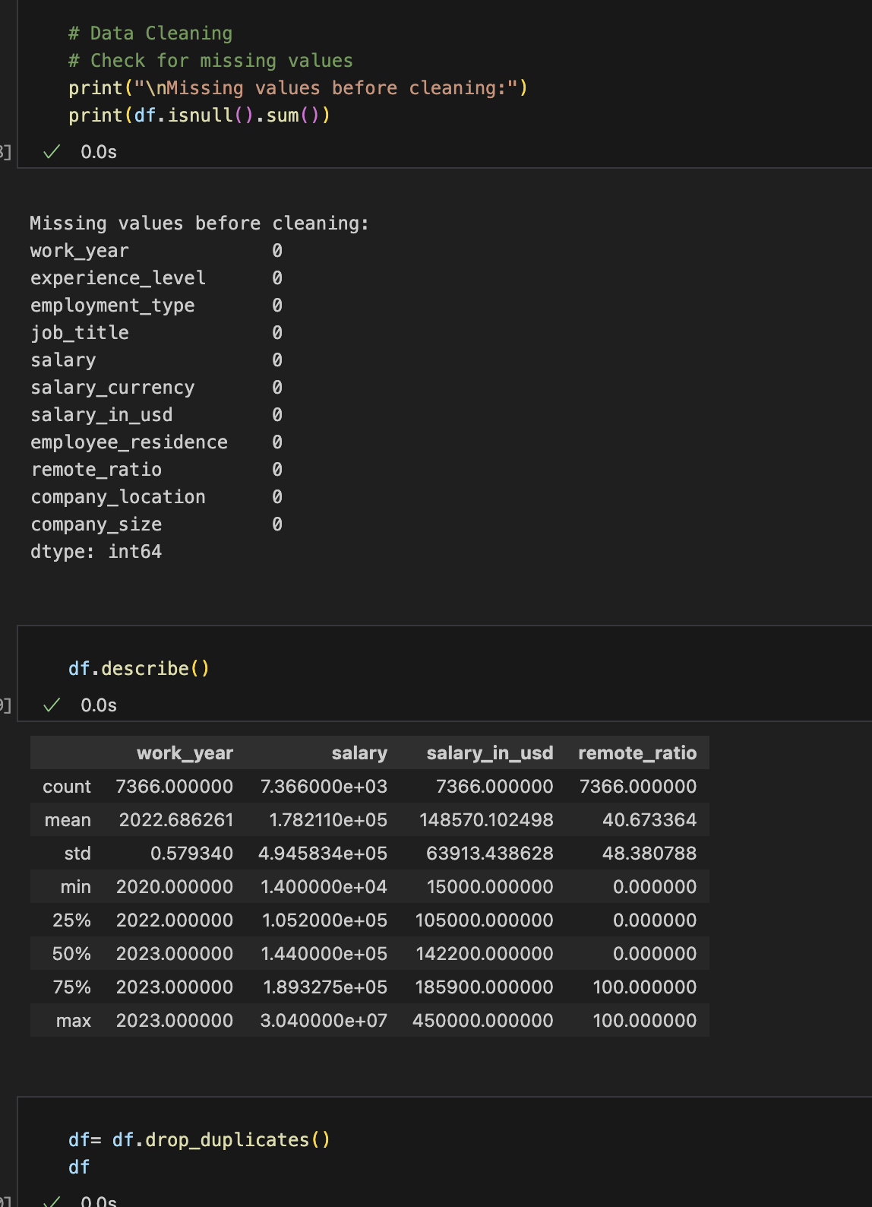
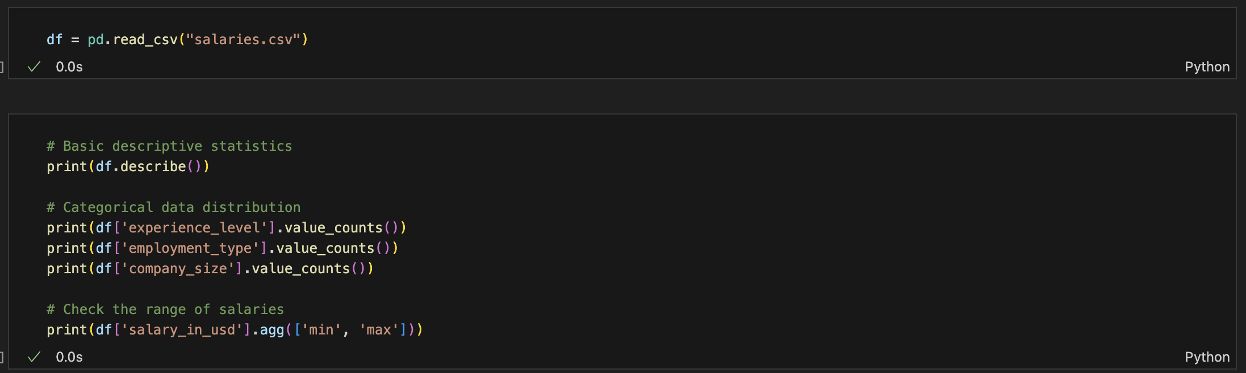
Data Acquisition and Preparation

Slide 12
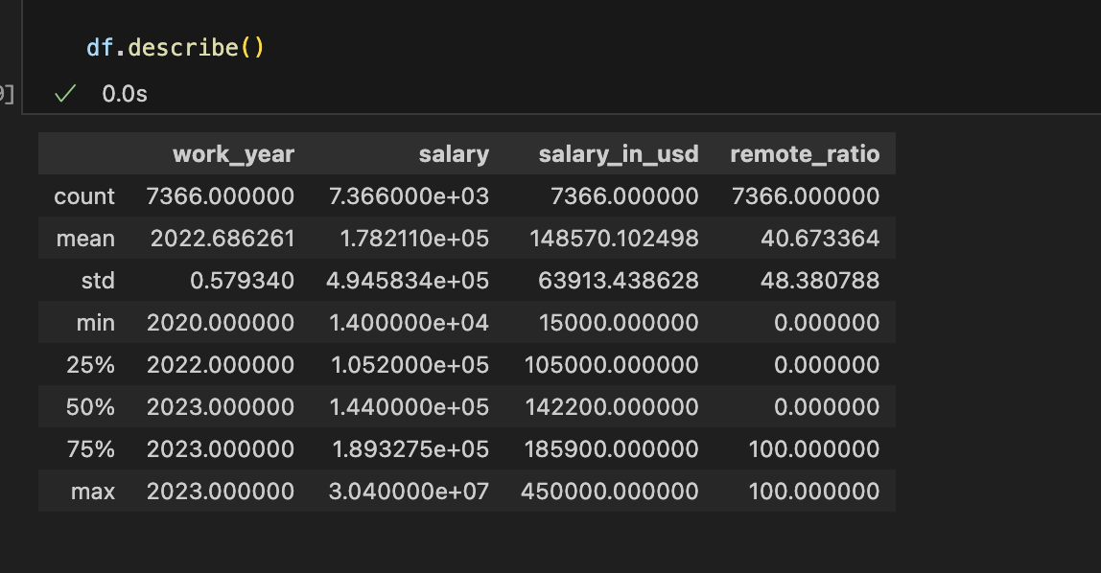
Descriptive Analysis
Basic descriptive statistics of the dataset:
The dataset contains 4,414 entries after data cleaning.
The average salary in USD is $143,743, with a standard deviation of $67,131.
Salaries range from a minimum of $15,000 to a maximum of $450,000.

Slide 13
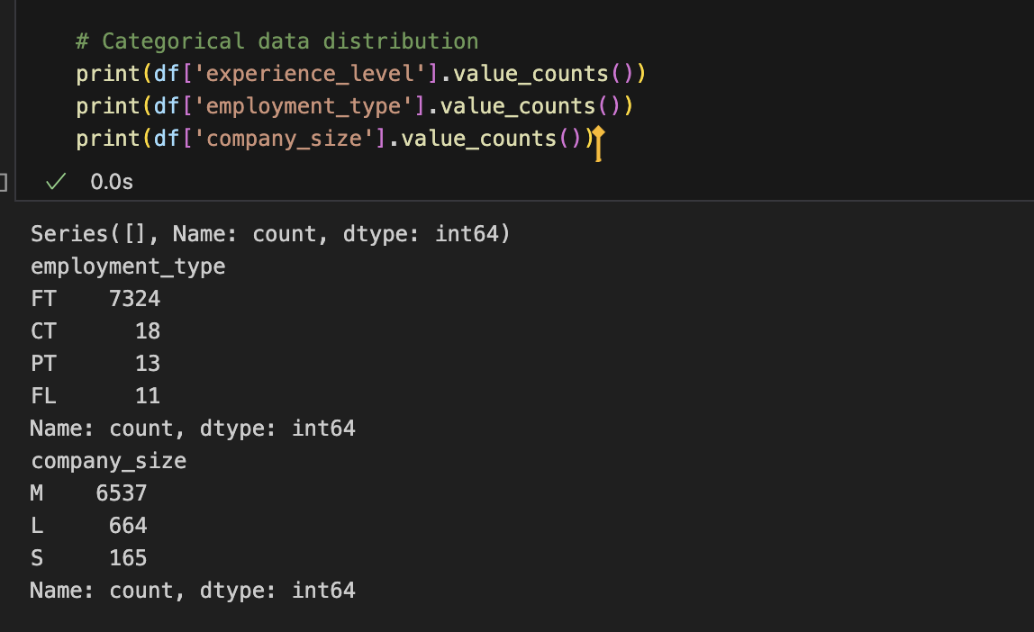
Distribution of categorical variables:
Experience level: Senior-level positions dominate the dataset with 2,848 entries.
Mid-level and entry-level positions follow with 1,046 and 336 entries, respectively.
Executive-level positions have the least representation with 184 entries.
Employment type: Full-time positions are the most common with 4,372 entries.
Other employment types (contract, part-time, freelance) have significantly fewer entries.
Company size: Medium-sized companies (50-250 employees) have the highest representation with 3,759 entries.
Large companies (>250 employees) and small companies (<50 employees) follow with 491 and 164 entries, respectively.

Slide 14
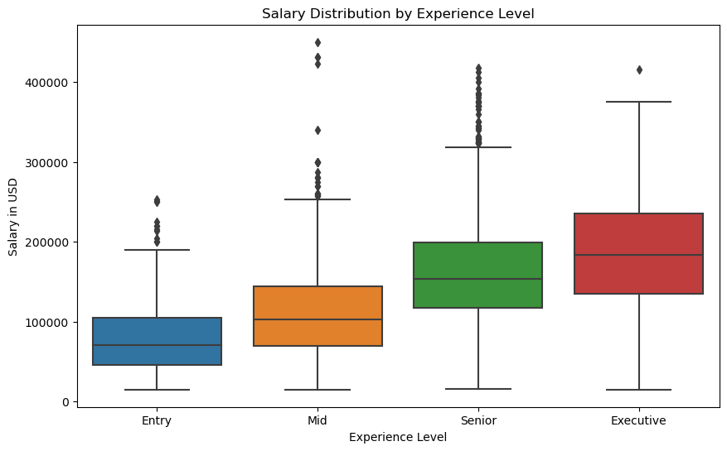
Salary Distribution by Experience Level
Observations: Higher experience levels generally have higher salaries.
There is a significant difference in salary ranges between experience levels.
The median salary increases with each higher experience level.
The boxplot reveals the presence of outliers, particularly in the senior, mid and executive levels.

Slide 15
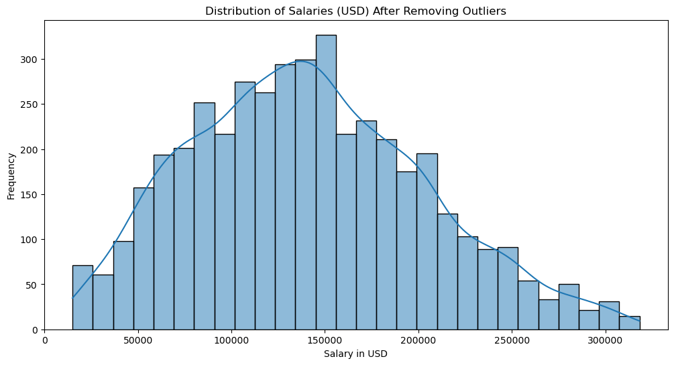
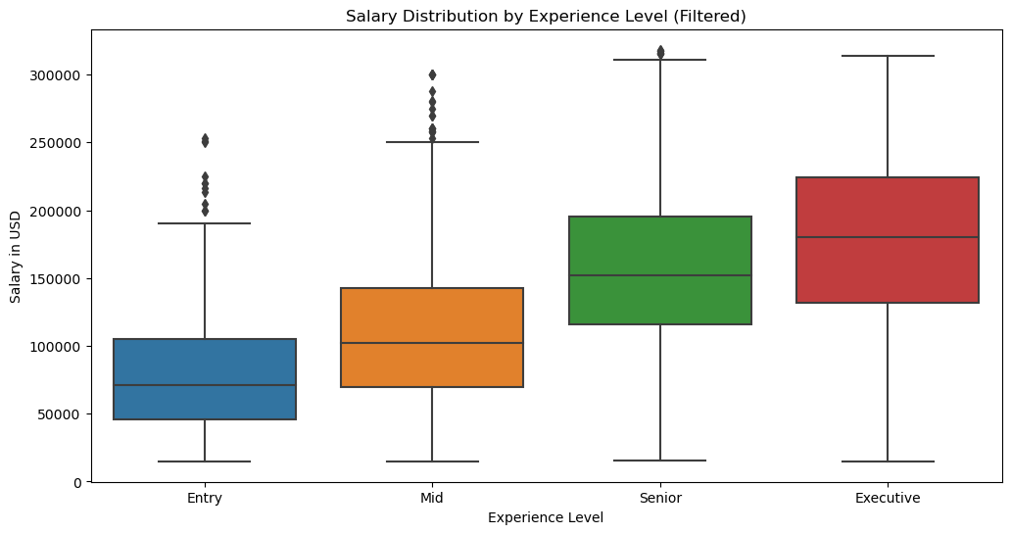
Handling Outliers and Filtered Salary Distribution
Identified and removed outliers using the Interquartile Range (IQR) method. Outliers are defined as data points below Q1 - 1.5 × IQR or above Q3 + 1.5 × IQR.
Distribution of salaries after removing outliers: (See img)
The histogram shows a more symmetric distribution of salaries after removing outliers.
The density curve suggests a slightly right-skewed distribution.
Boxplot of salary distribution by experience level after filtering outliers: [see img]
Observations: Removing outliers provides a clearer view of the typical salary ranges within each experience level.
The overall distribution pattern remains similar after filtering outliers, with higher salaries associated with higher experience levels.

Slide 16
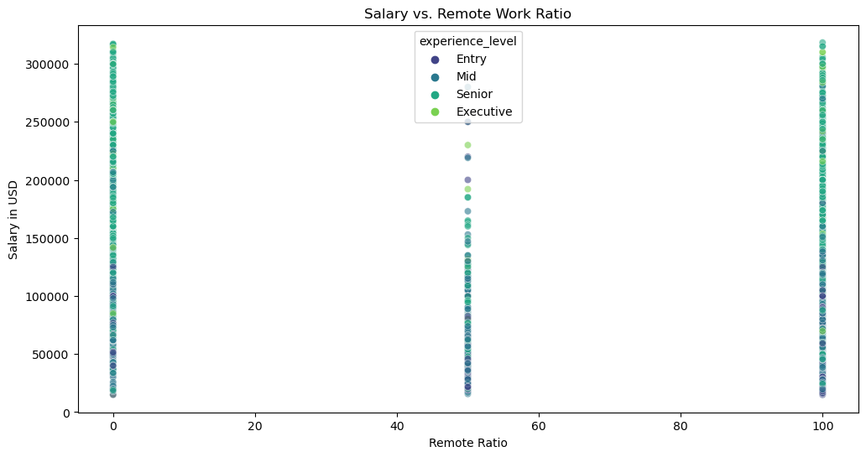
Salary vs. Remote Work Ratio
Scatterplot of salary vs. remote work ratio, colored by experience level: [see img]
Observations: There is no clear correlation between salary and remote work ratio.
Salaries vary across different remote work ratios within each experience level.
The scatterplot suggests that remote work ratio alone does not significantly influence salary levels.

Slide 17
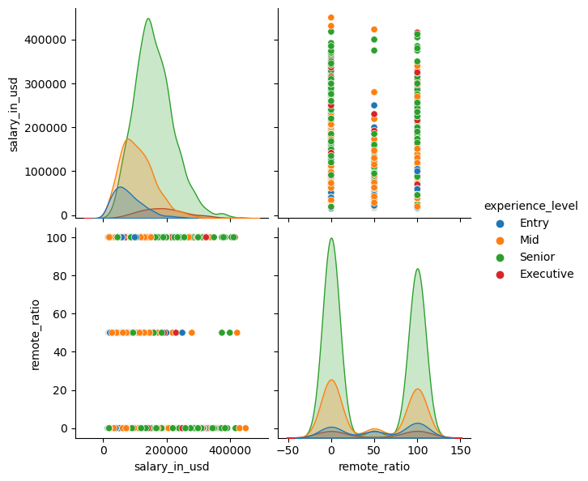
Pair Plot of Select Features
Observations:
The pair plot matrix provides a visual overview of the relationships between the selected features.
There is a positive correlation between salary and experience level, as evident from the increasing trend in the scatter plots.
The relationship between salary and remote ratio is less clear, with no apparent pattern.
The distribution of remote ratios appears similar across experience levels.

Slide 18
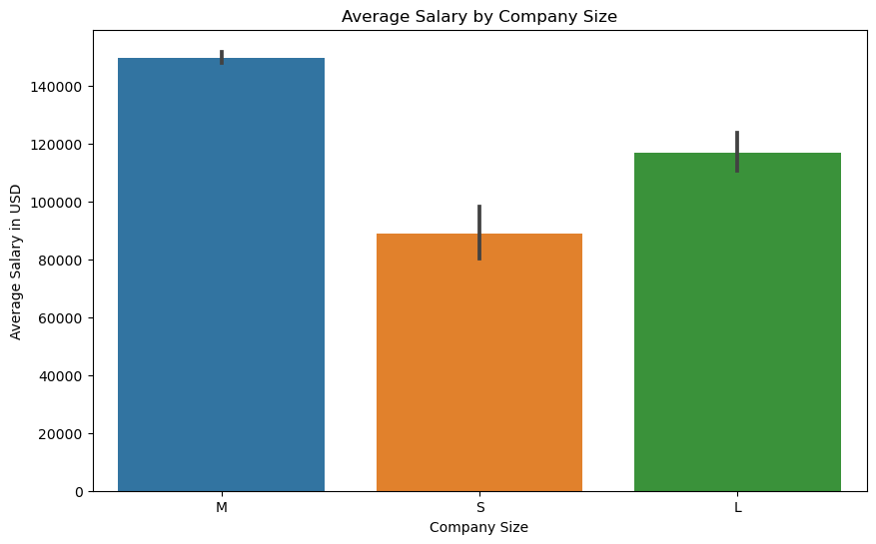
Average Salary by Company Size
Observations:
Larger companies tend to offer higher average salaries compared to smaller companies.
Surprisingly, medium companies offer higher salary compared to larger ones
The average salary increases with each increment in company size: small < large < medium.
The differences in average salaries between company sizes are notable, suggesting company size plays a role in determining salaries.

Slide 19
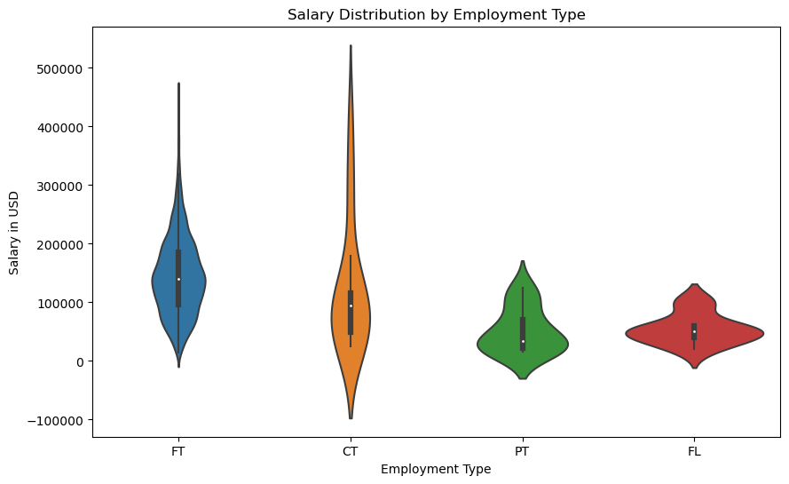
Salary Distribution by Employment Type
Observations:
Full-time positions have the widest salary range and the highest median salary.
Contract and freelance positions have lower salary ranges and medians compared to full-time positions.
Part-time positions have the lowest salary range and median among the employment types.
The violin plot reveals the presence of outliers in the full-time category.

Slide 20
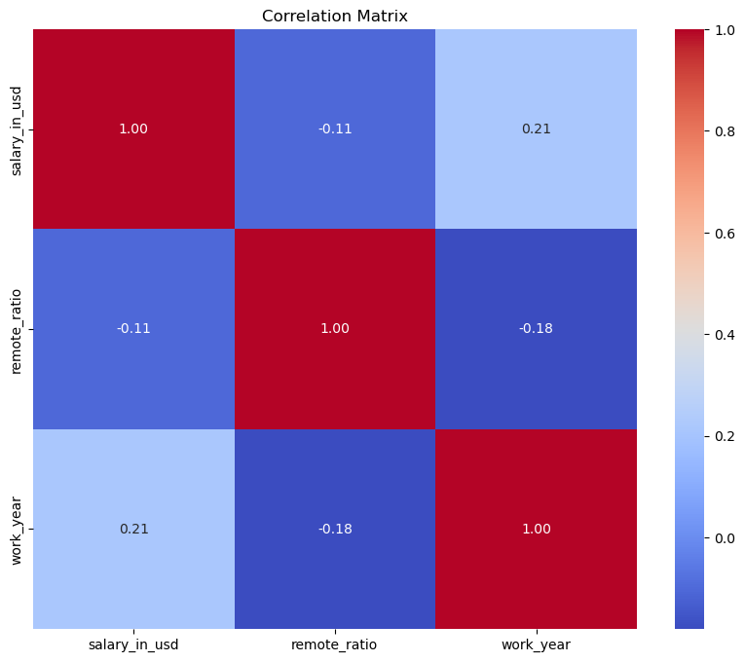
Correlation Matrix
There is a weak negative correlation between salary and remote ratio (-0.11). This means that there is a slight tendency for salaries to be lower for jobs with a higher remote ratio.
There is a weak positive correlation between salary and work years (0.21). This means that there is a slight tendency for salaries to be higher for people with more work experience.
There is a weak negative correlation between remote ratio and work years (-0.18). This means that there is a slight tendency for jobs with a higher remote ratio to have fewer work experience requirements.

Slide 21
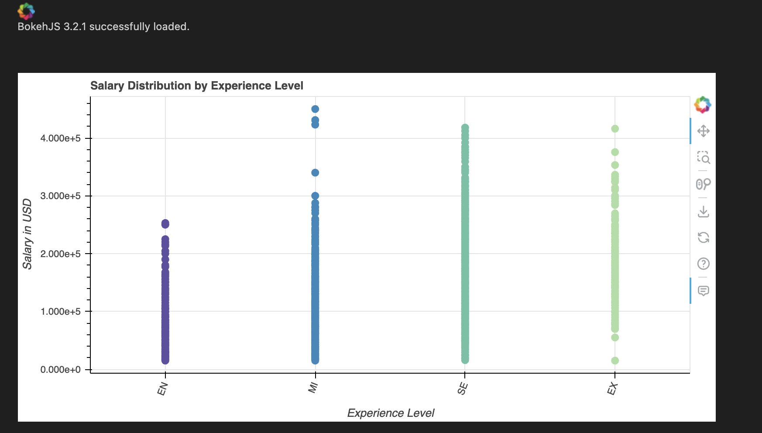
Interactive Salary Distribution by Experience Level (Bokeh)
Features: The plot allows for interactive exploration of salary distribution across experience levels.
Hovering over data points provides additional information, such as the specific salary, job title, and experience level.
The plot is customizable, with options to adjust the plot size, colors, and label orientations.
The interactive nature of the plot enhances the user's ability to analyze and derive insights from the data.

Slide 22
Conclusions and Future Improvements
Key Findings
Limitations and Future Improvements

Slide 23
Key findings:
Salaries in the AI/ML field vary significantly based on experience level, with higher levels associated with higher salaries.
Company size and employment type also influence salary ranges, with larger companies and full-time positions offering higher salaries on average.
Remote work ratio does not appear to have a strong impact on salaries in this dataset.

Slide 24
Limitations and future improvements:
The dataset has limited data points for certain categories, such as freelance and part-time positions, which may affect the generalizability of the findings.
Expanding the dataset to include more diverse job titles and industries within the AI/ML field could provide a more comprehensive analysis.
Collecting additional features, such as education level and specific skills, could enhance the explanatory power of the analysis and provide deeper insights into salary determinants.
Exploring advanced modeling techniques, such as regression analysis or machine learning, could uncover more complex relationships and predict salaries based on multiple factors.

